Slide 1


BEST PRACTICES BRIEFING
Enrollment
Forecasting,
Capacity, and
Utilization Analysis
PREPARED FOR
Olathe Public Schools
Student Enrollment & Facility Alignment Task Force
Best Practices and an Assessment of Current Models
Demographic Analytics Advisors
April 28, 2026

Slide 2
ABOUT US
About Demographic Analytics Advisors
A few words about who we are and why we are here today.
What We Do
CD
Christopher Dick
President and Founder
Demographic Analytics Advisors is a small firm of demographers and data scientists. We work with public school districts on enrollment forecasting, capacity and utilization analysis, redistricting, and related demographic studies. Our role is to bring demographic method to questions where local expertise is the other half of the answer.
Former statistician and demographer at the U.S. Census Bureau. Works with public school districts and with local and state governments to help them understand the populations they serve.
Other Principals
Beth Jarosz. Senior Vice President of Forecasting and Demography.
Dr. Ronald Prevost. Senior Vice President for Demography.
Introduction · p. 2

Slide 3
ROADMAP
What we’ll cover today
A quick map of where we’re going.
1
Context setting
What does Olathe look like today? Demographics, enrollment trends, housing, and the forces shaping the district’s near-term trajectory.
2
Best practices
What goes into credible enrollment forecasting, capacity measurement, and utilization analysis — the data, the methods, and how to know whether you can rely on it.
3
Where Olathe stands
A first read on where the district’s current forecasting and utilization work stands, and a few things we think are worth discussing.
Introduction · p. 3

Slide 4
01
CONTEXT SETTING
What does Olathe
look like today?
Demographics, enrollment trends, housing, and the forces shaping the district’s near-term trajectory.
01 · Context Setting · p. 4

Slide 5
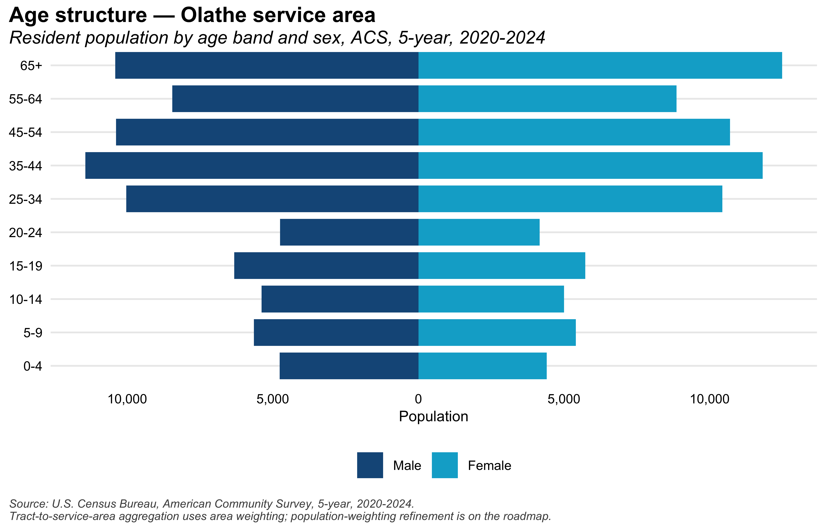
01 · CONTEXT SETTING
Age structure of the Olathe service area
Population by age and sex, ACS 5-year 2020–2024. The width of each bar shows the number of residents in that age band.
Source: U.S. Census Bureau, American Community Survey, 5-year estimates, 2020–2024. Tabulated to Olathe USD 233 service-area tracts.
01 · Context Setting · p. 5
Notes:
Importance of age structure for enrollment forecasting.
This has changed a lot over the last 20 years.

Slide 6
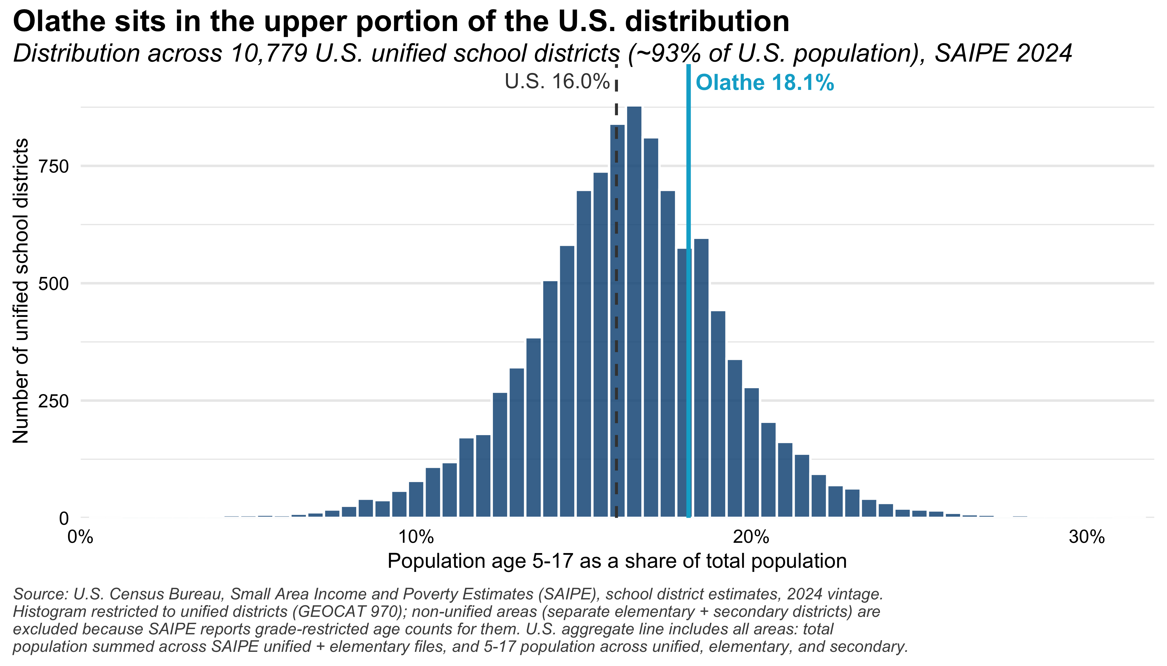
01 · CONTEXT SETTING
Where Olathe sits among U.S. school districts
Distribution of the 5–17-to-total-population share across unified school districts (SAIPE 2024). Olathe’s share marked in teal.
Source: Census Bureau SAIPE, 2024. Olathe vertical line marks the district’s school-age population share.
01 · Context Setting · p. 6
Notes:
Where Olathe sits compared to other school districts
In the top 25% of children per total population.
The mean has changed a lot over the last 20 years.

Slide 7
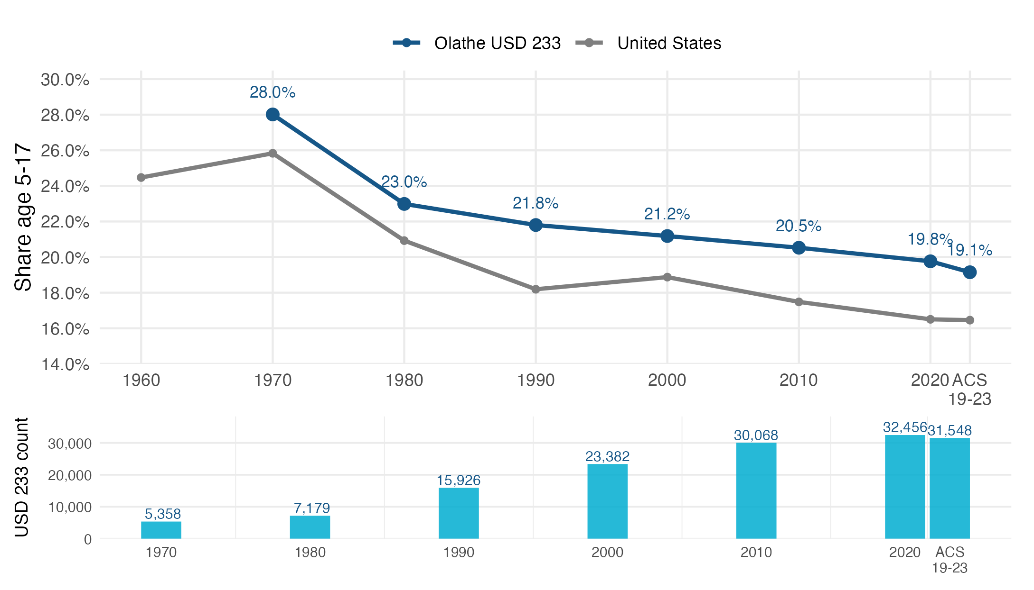

01 · CONTEXT SETTING
Where Olathe’s school-age share has been over time
USD 233 share of population age 5–17, current district boundary, 1970 through 2020 plus the 2019–2023 ACS, with U.S. national reference. 1960 omitted: the 1960 SMSA tract publication did not extend to the rural Olathe area.
Sources: NHGIS (1960–1990 NT18 / NT2A / NT12A / NP11) and U.S. Census Bureau decennial (2000 SF1, 2010 SF1, 2020 DHC; P12) and ACS 5-year 2019–2023 (B01001). Methodology: block-centroid (1990–2020) and tract-dasymetric (1970, 1980) reaggregation to the 2024 USD 233 boundary; 2010 and 2020 reaggregated values match the Census-published school-district figures exactly (0.00 percent delta).
01 · Context Setting · p. 7

Slide 8
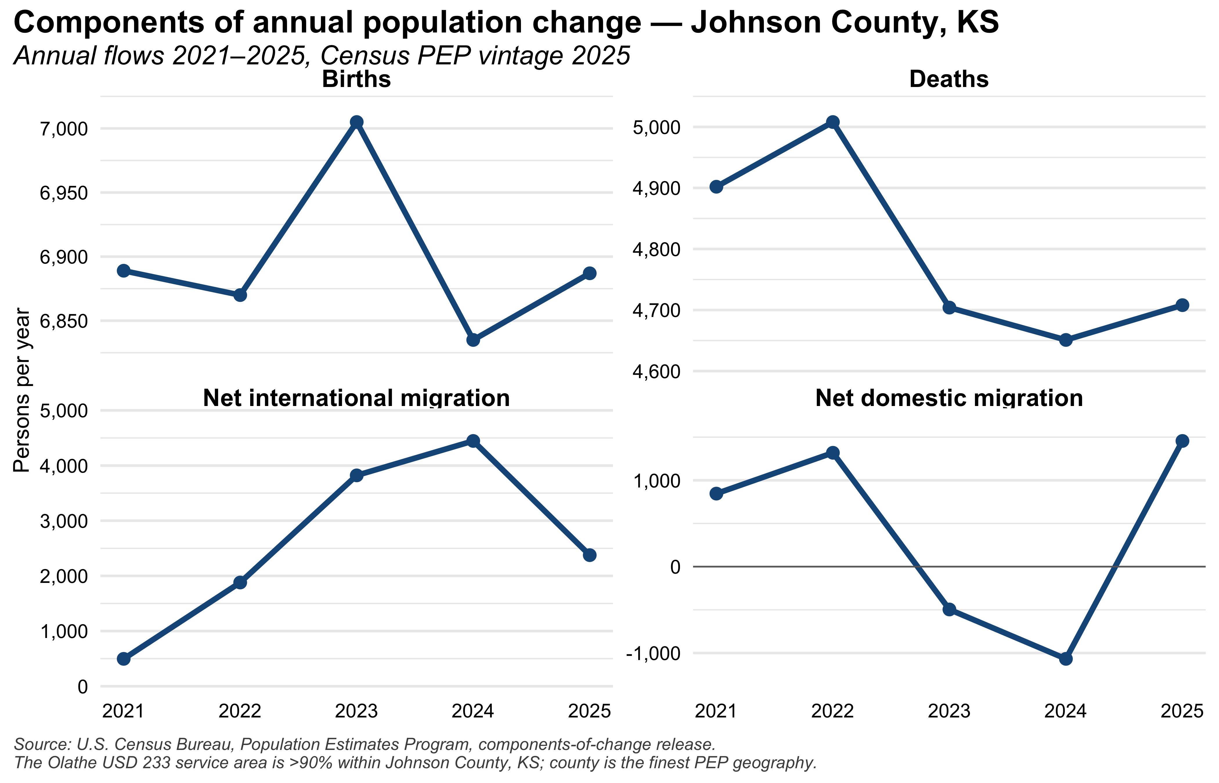
01 · CONTEXT SETTING
Components of population change, Johnson County
Annual births, deaths, and net migration flows. Johnson County is used as a county-level approximation of the Olathe service area.
Source: Census Bureau Population Estimates Program (PEP), components of change, Johnson County, KS.
01 · Context Setting · p. 8

Slide 9
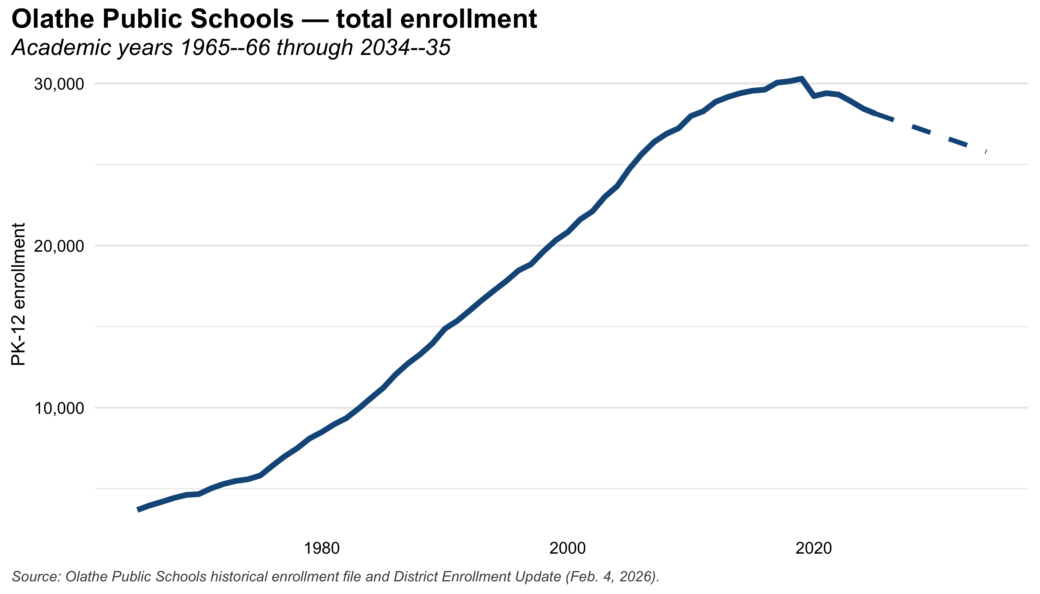
01 · CONTEXT SETTING
Total PK–12 enrollment, 1965 through 2035
Solid line is historical enrollment; dashed segment is the district’s nine-year projection.
Source: Olathe Public Schools enrollment records and district enrollment projection model.
01 · Context Setting · p. 9

Slide 10
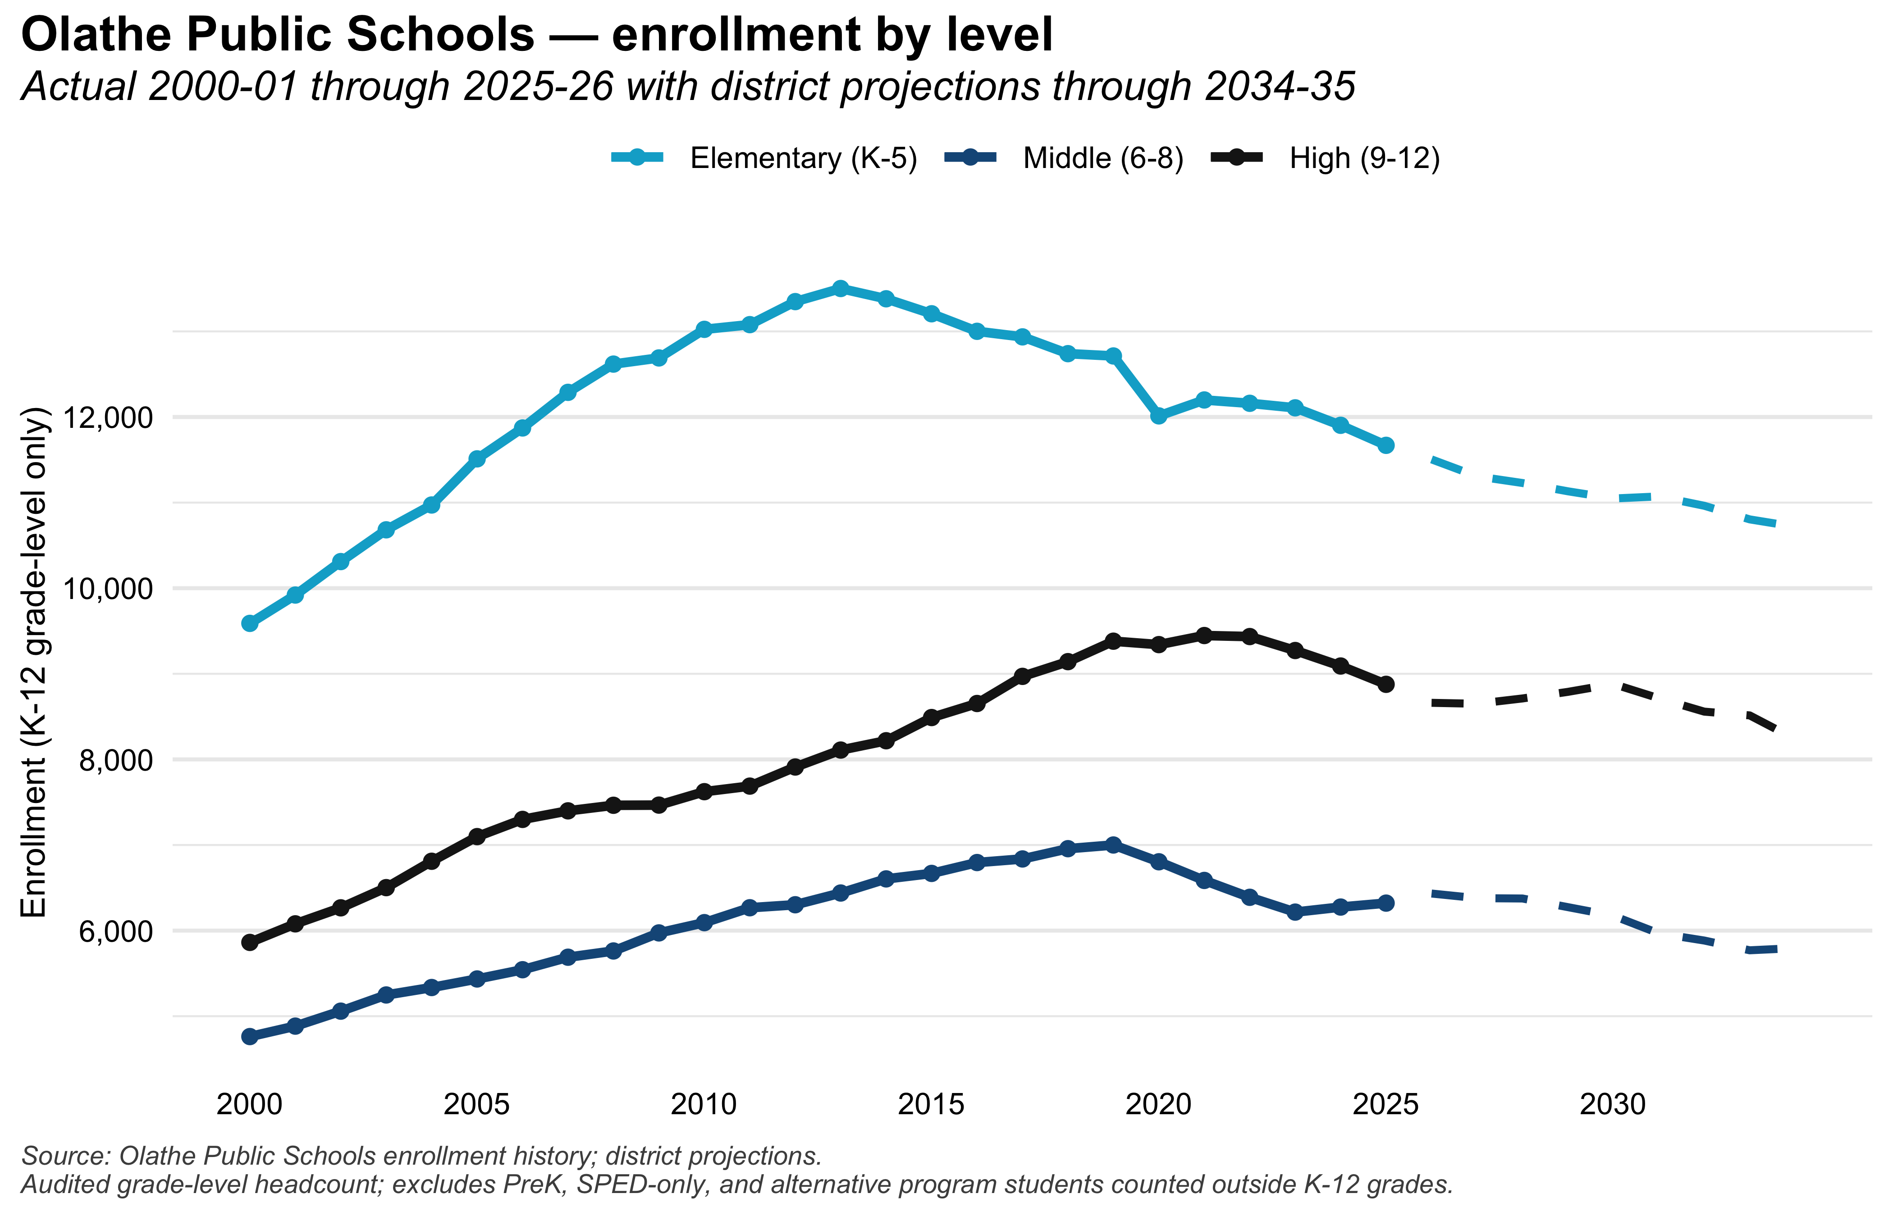
01 · CONTEXT SETTING
Enrollment by grade band, 2000 through 2035
Elementary (K–5), middle (6–8), and high (9–12). Dashed lines show district projections.
Source: Olathe Public Schools enrollment records and district enrollment projection model.
01 · Context Setting · p. 10

Slide 11
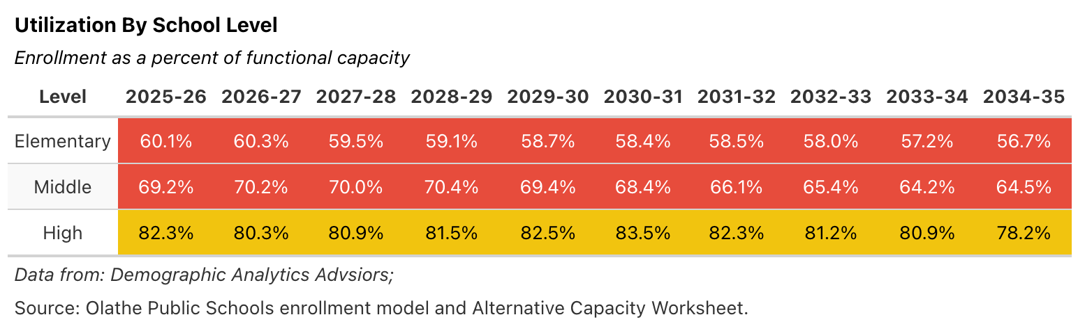
01 · CONTEXT SETTING
Utilization by school level, 2025–26 through 2034–35
Aggregate utilization at each school level. Color bands: green (85–100%), yellow (75–85%), red (<75%), orange (>100%).
Functional capacity basis. Source: DAA analysis of district enrollment model and Alternative Capacity Worksheet.
01 · Context Setting · p. 11

Slide 12
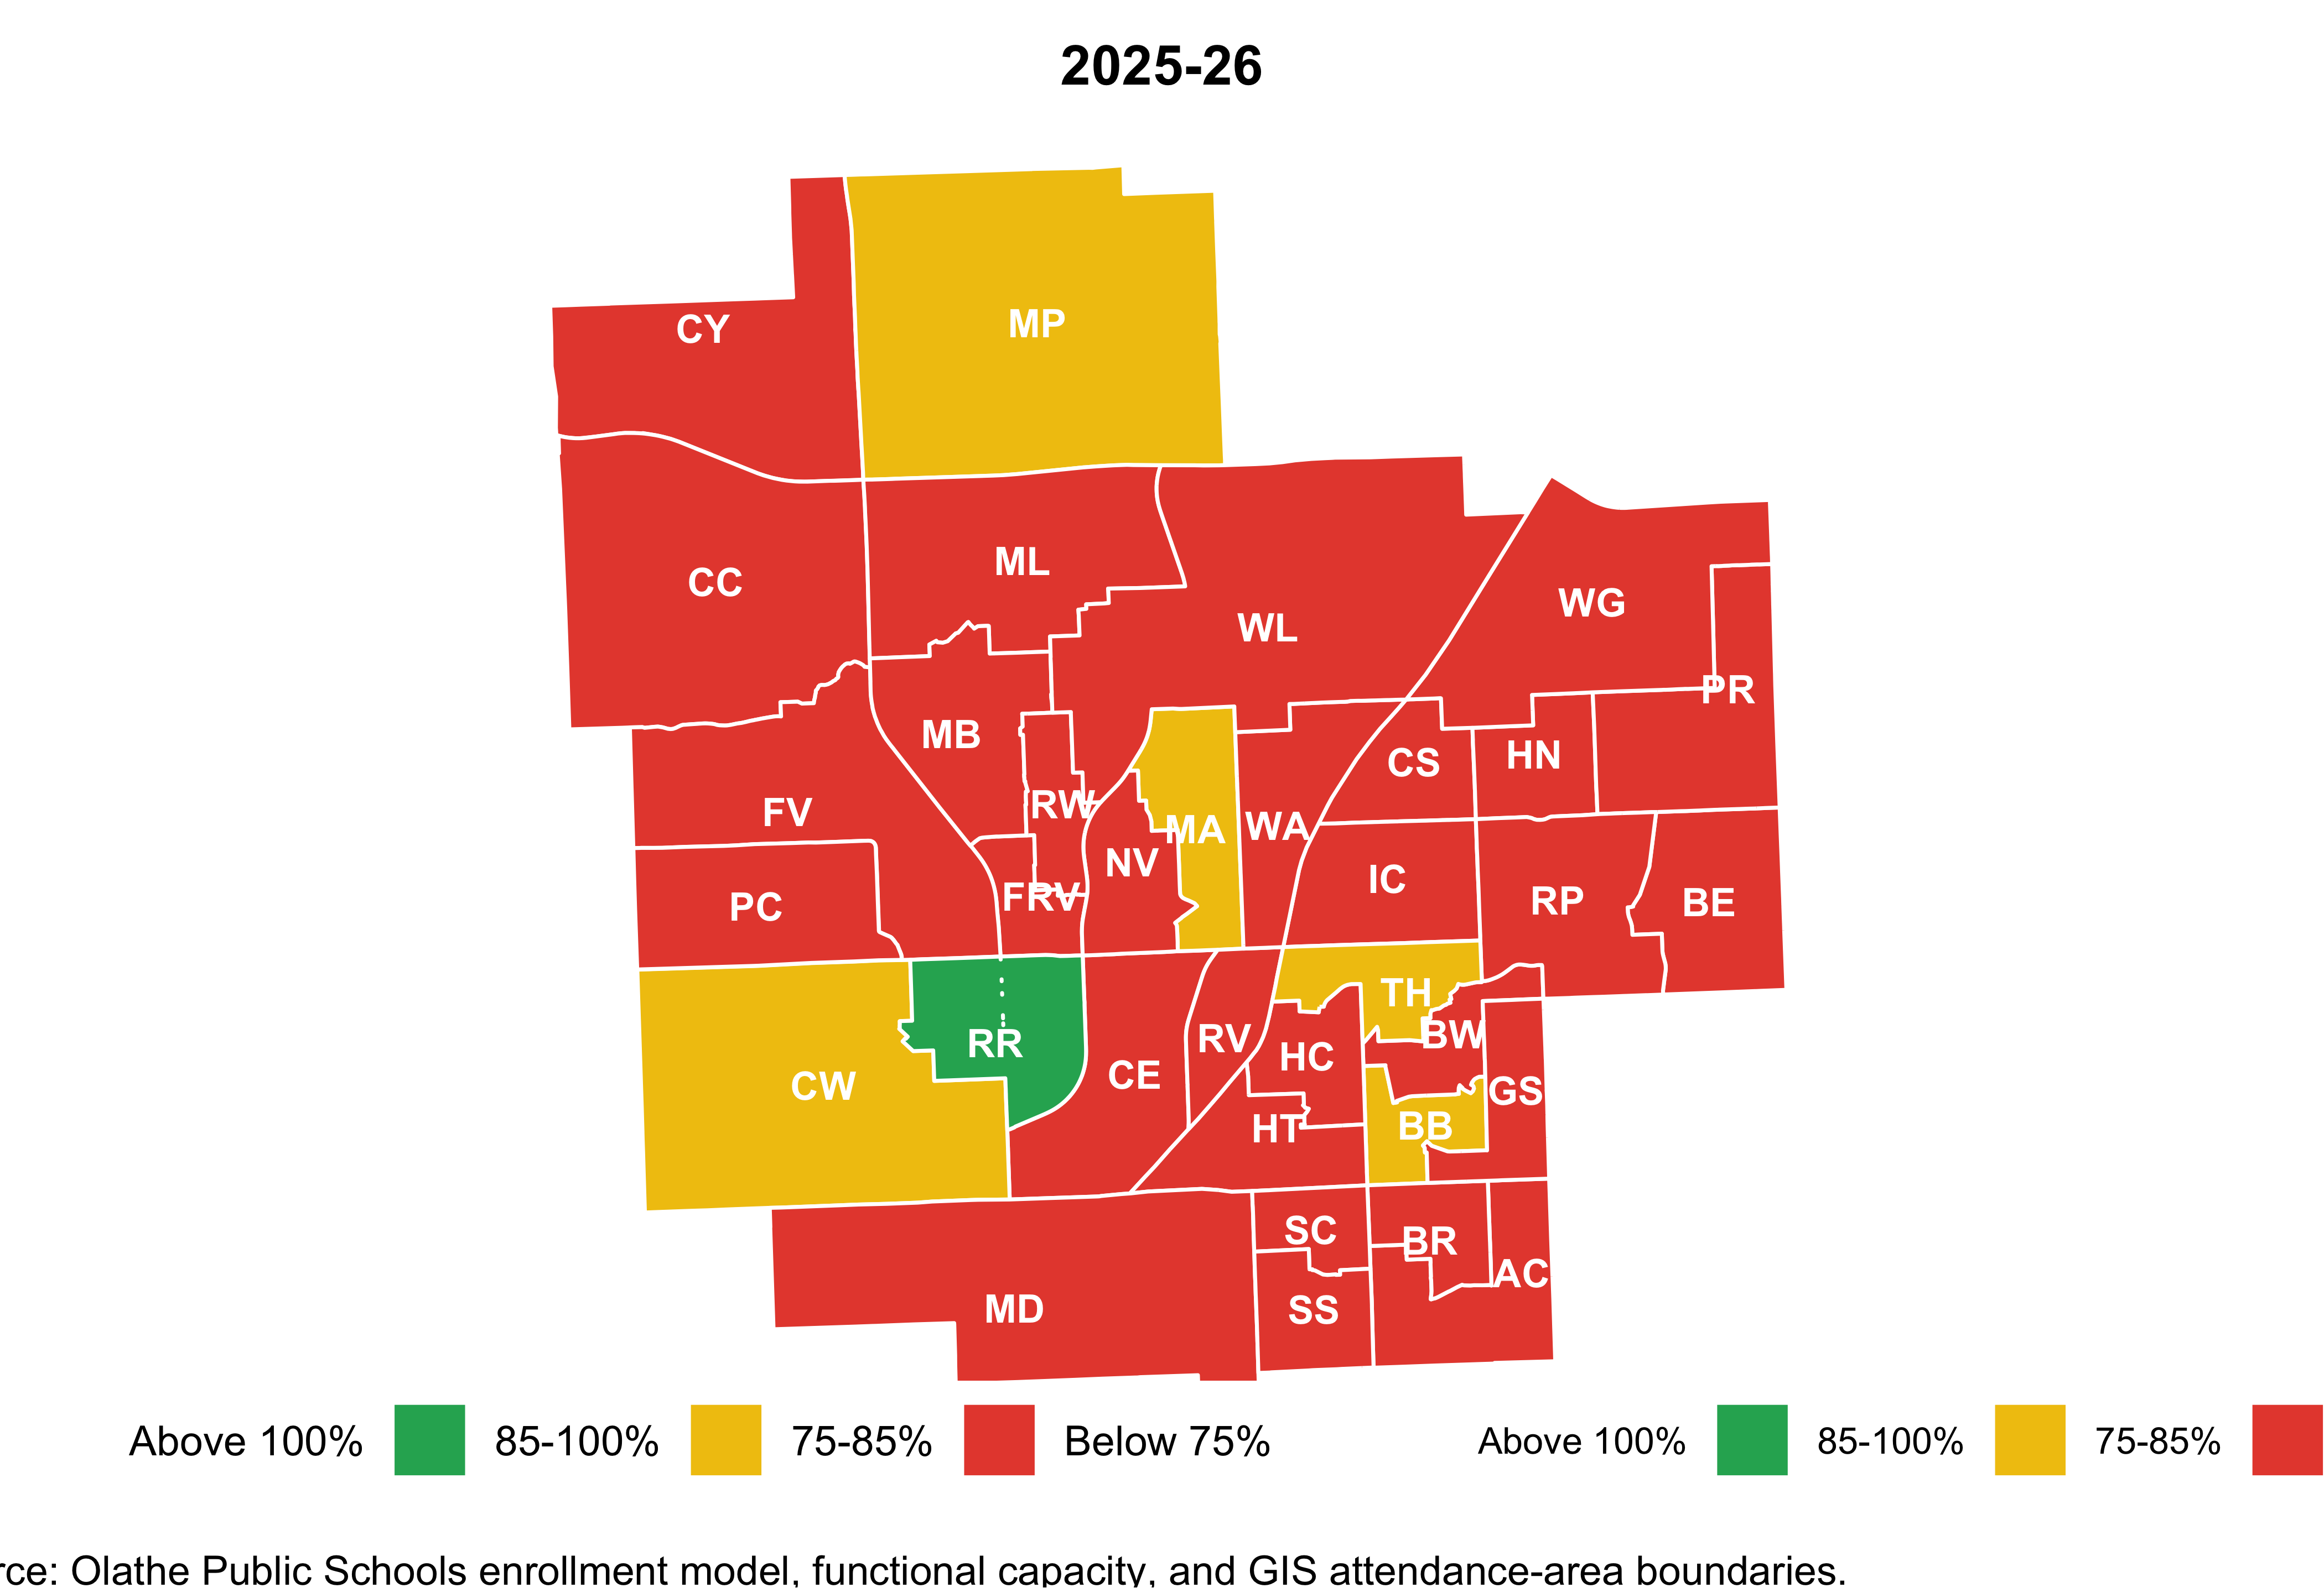
01 · CONTEXT SETTING
Elementary utilization by attendance area, 2025–26
Current-year utilization. Each attendance area is colored by its utilization tier. Codes match the table on the following slides.
Functional capacity basis. Source: DAA analysis of district enrollment model and Alternative Capacity Worksheet.
01 · Context Setting · p. 12

Slide 13
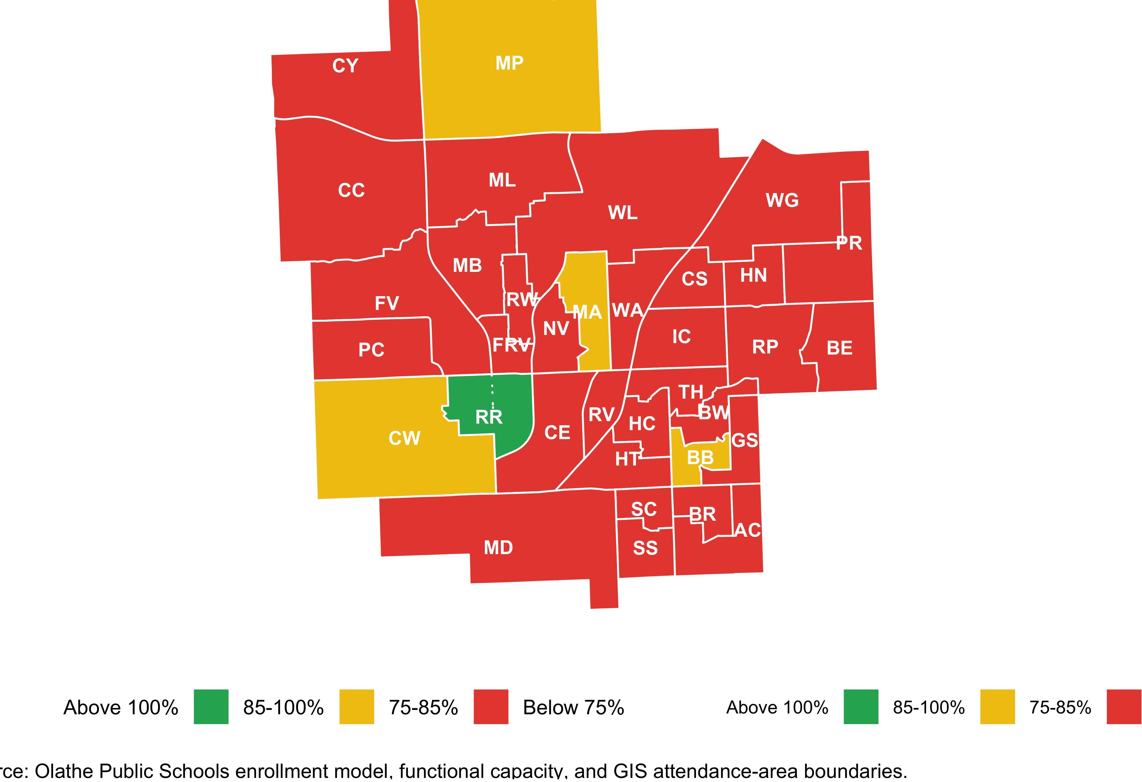
01 · CONTEXT SETTING
Elementary utilization by attendance area, 2034–35
Projected utilization nine years out. Compare with the 2025–26 map on the previous slide to see which areas are shifting.
Functional capacity basis. Source: DAA analysis of district enrollment model and Alternative Capacity Worksheet.
01 · Context Setting · p. 13

Slide 14
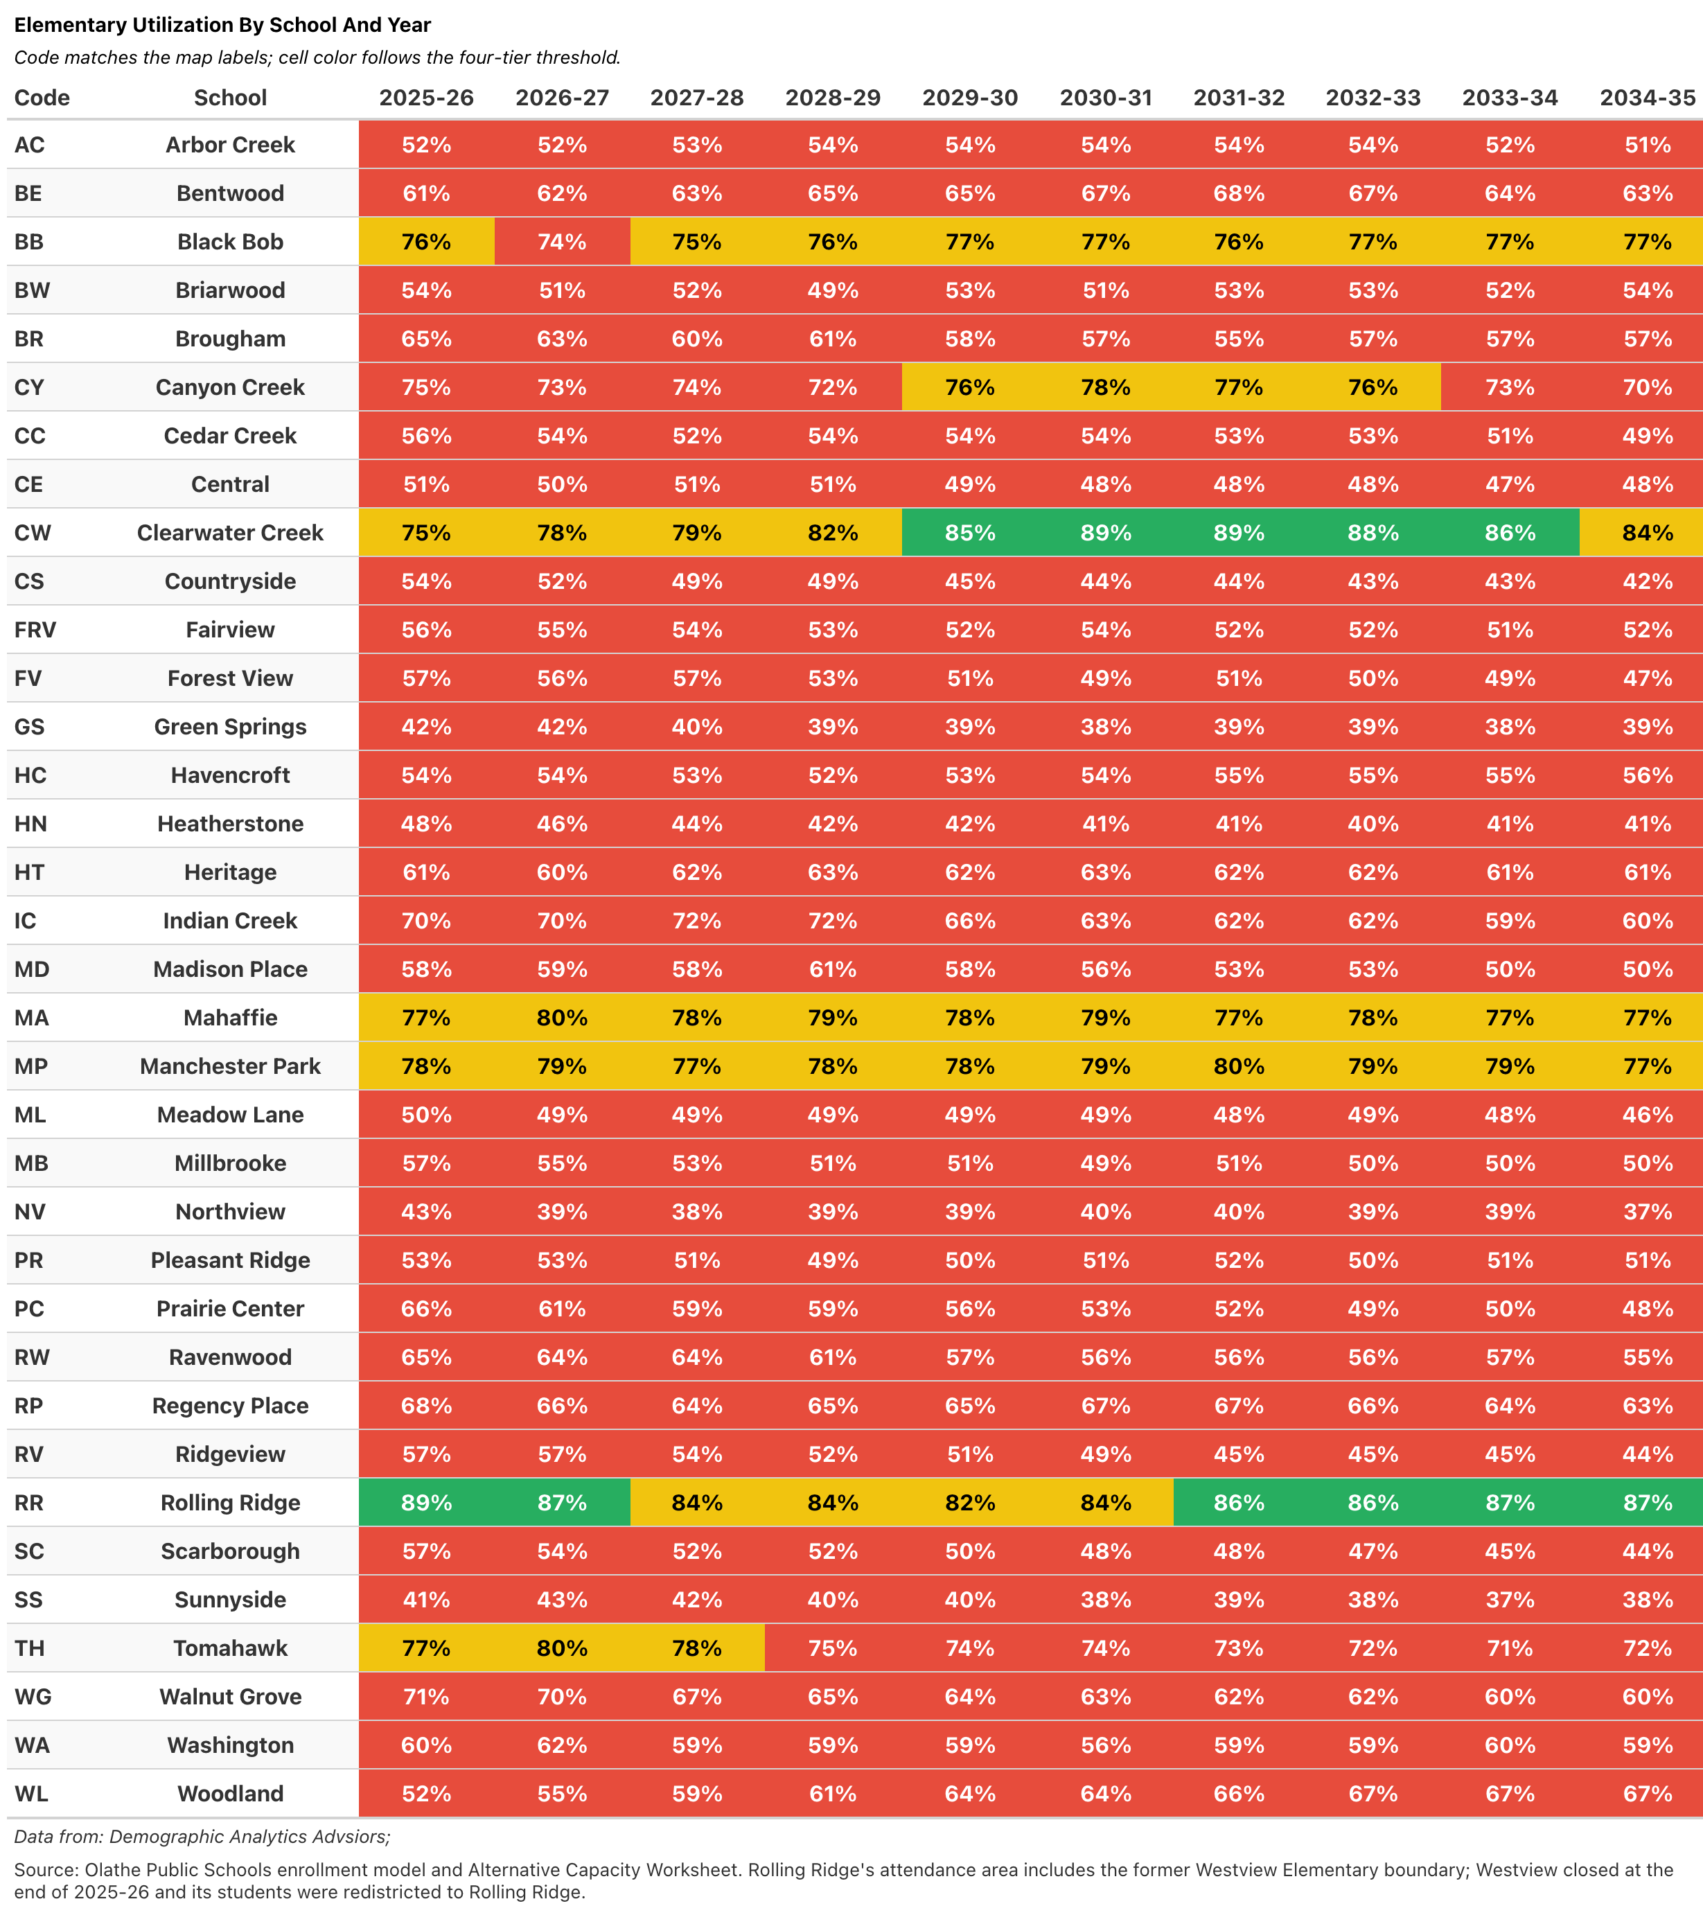
01 · CONTEXT SETTING
Elementary school utilization detail (1 of 2)
Schools A through M. Ten-year utilization trajectory for each elementary school, functional capacity basis.
Functional capacity basis. Source: DAA analysis of district enrollment model and Alternative Capacity Worksheet.
01 · Context Setting · p. 14

Slide 15
01 · CONTEXT SETTING
Elementary school utilization detail (2 of 2)
Schools M through W. Continued from previous slide.
Functional capacity basis. Source: DAA analysis of district enrollment model and Alternative Capacity Worksheet.
01 · Context Setting · p. 15

Slide 16
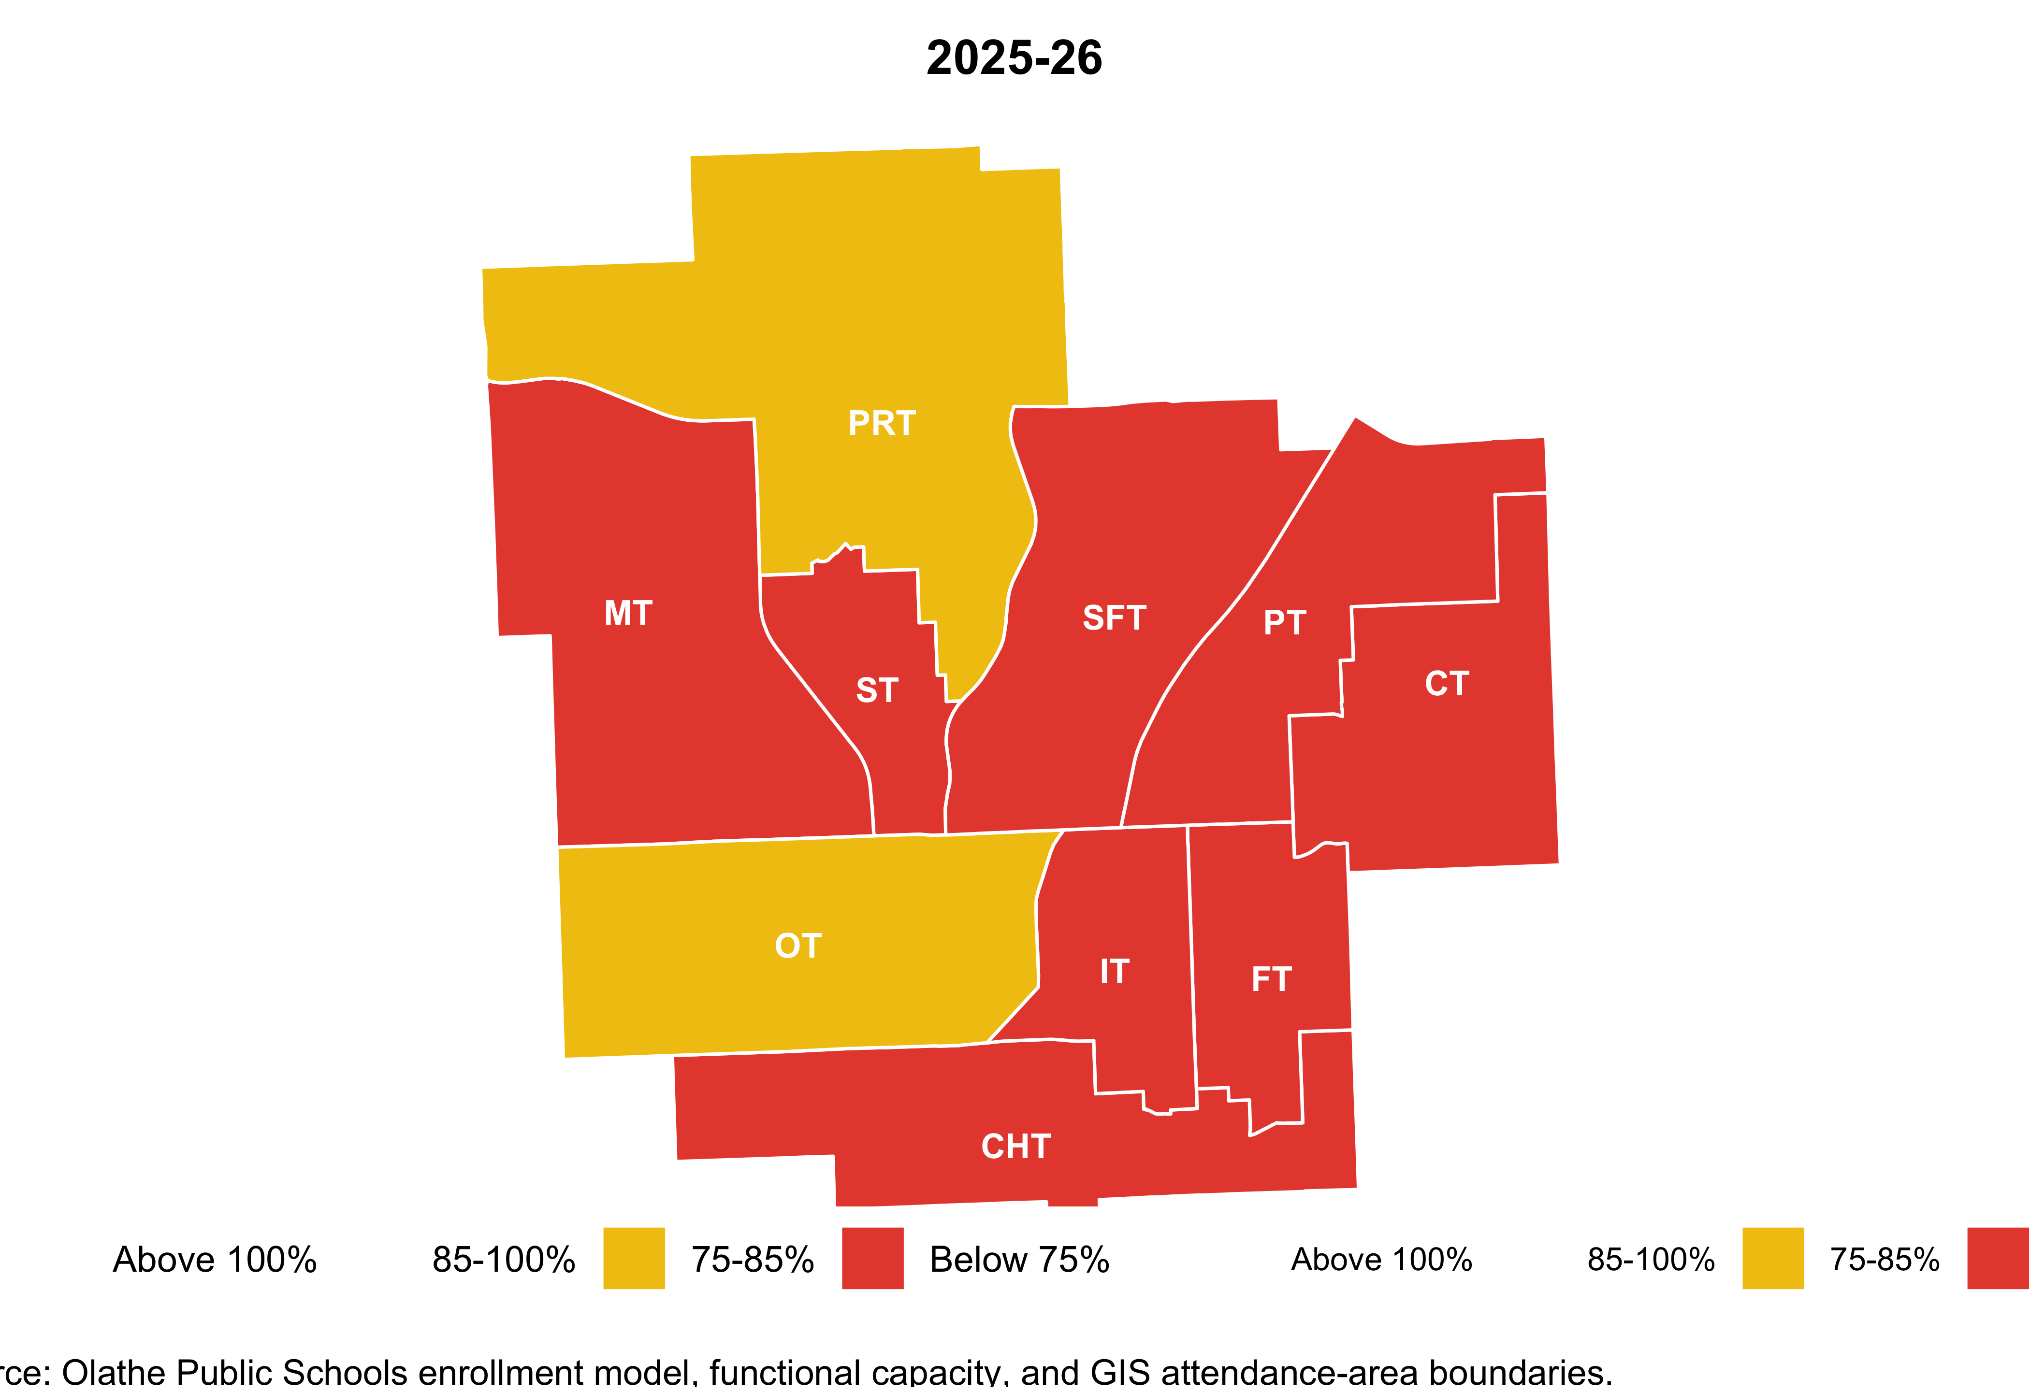
01 · CONTEXT SETTING
Middle school utilization by attendance area, 2025–26
Ten middle schools. Current-year utilization by attendance area.
Functional capacity basis. Source: DAA analysis of district enrollment model and Alternative Capacity Worksheet.
01 · Context Setting · p. 16

Slide 17
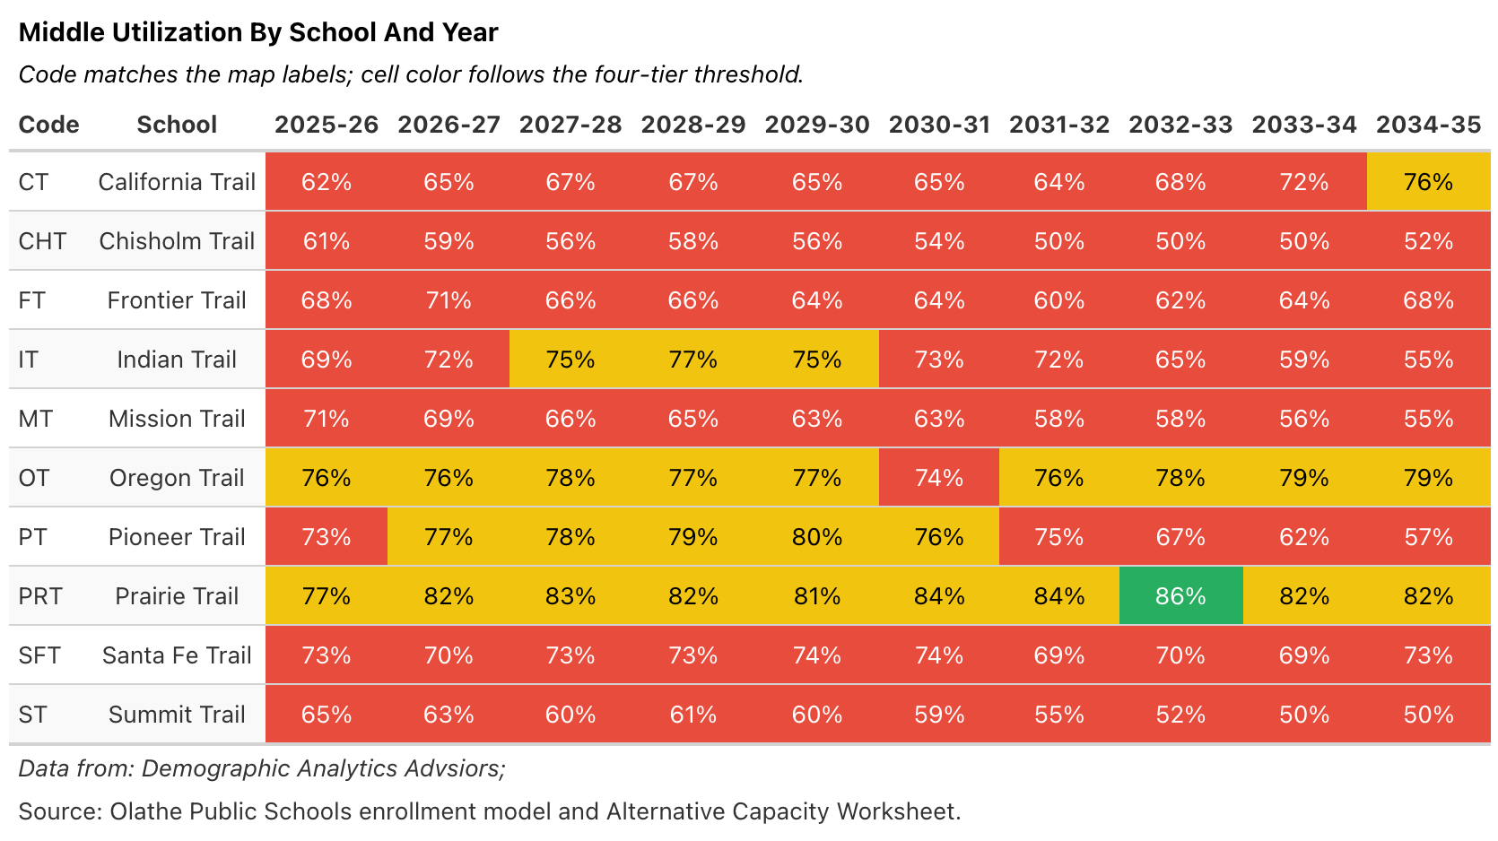
01 · CONTEXT SETTING
Middle school utilization detail, 2025–26 through 2034–35
Ten-year utilization trajectory for each middle school. Color bands match the map on the previous slide.
Functional capacity basis. Source: DAA analysis of district enrollment model and Alternative Capacity Worksheet.
01 · Context Setting · p. 17

Slide 18
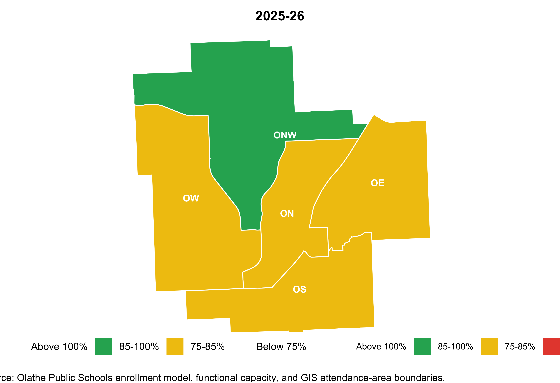
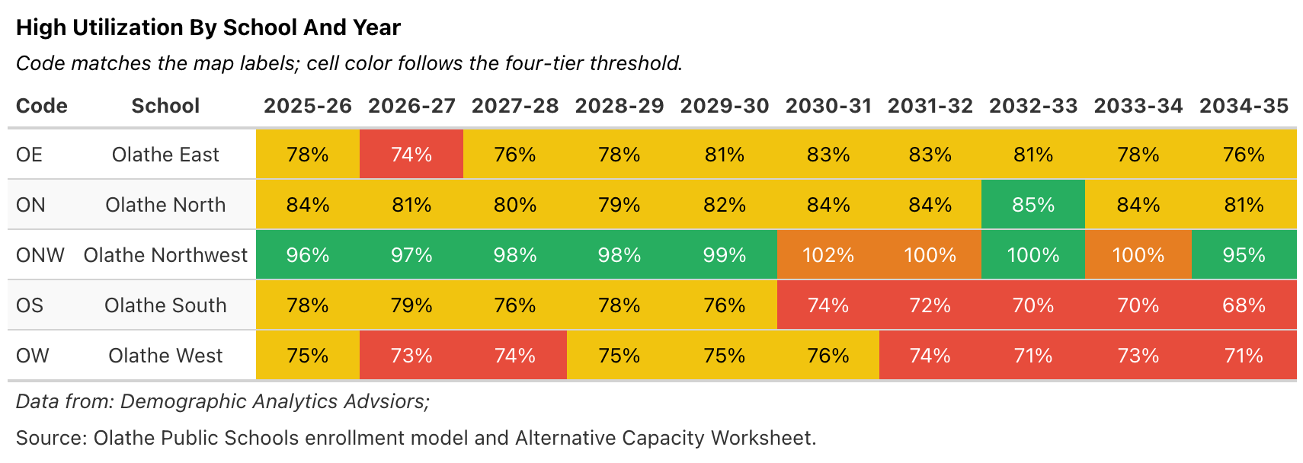
01 · CONTEXT SETTING
High school utilization, 2025–26
Five high schools. Current utilization map (top) and ten-year projection table (bottom).
Functional capacity basis. Source: DAA analysis of district enrollment model and Alternative Capacity Worksheet.
01 · Context Setting · p. 18

Slide 19
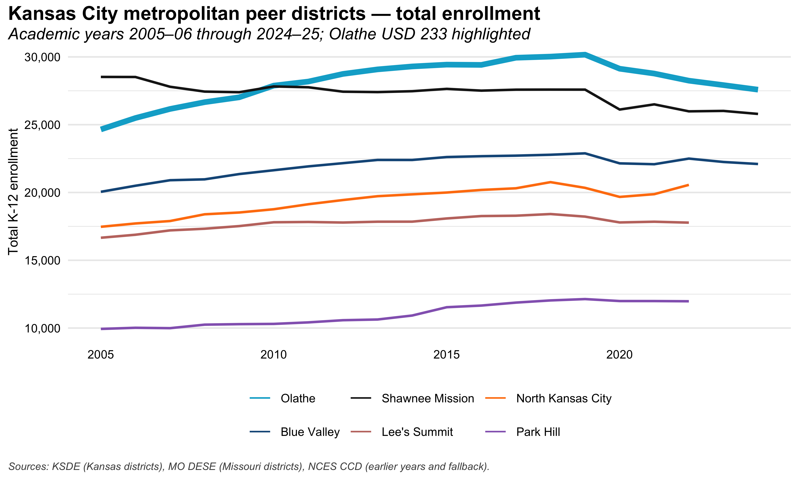
01 · CONTEXT SETTING
Olathe and its Kansas City metropolitan peer districts
Total K–12 enrollment for Olathe (bold) and five KC-metro peers. Olathe is the largest district in the peer set.
Source: Kansas Department of Education and NCES enrollment files. Olathe (USD 233) shown bold.
01 · Context Setting · p. 19

Slide 20
02
BEST PRACTICES
Best practices in
enrollment forecasting,
capacity, and utilization
The data, the methods, and how to know whether you can rely on the numbers.
02 · Best Practices · p. 20

Slide 21
IF YOU REMEMBER ONE THING
A forecast is really a set of “if-then” statements.
THE CORE IDEA
WHY THIS MATTERS FOR THE TASK FORCE
if.then.
Not a crystal ball. A tool for your decisions.
Your work is about buildings, boundaries, and programs — decisions that have to hold up even if things come in a little higher or a little lower than expected. A forecast that writes down what it assumed gives you something to push back on. One that doesn't, doesn't.
A forecast worth relying on says: “If today's patterns hold, here's what enrollment looks like — and here's which patterns would have to break to make it wrong.”
Introduction · p. 21

Slide 22
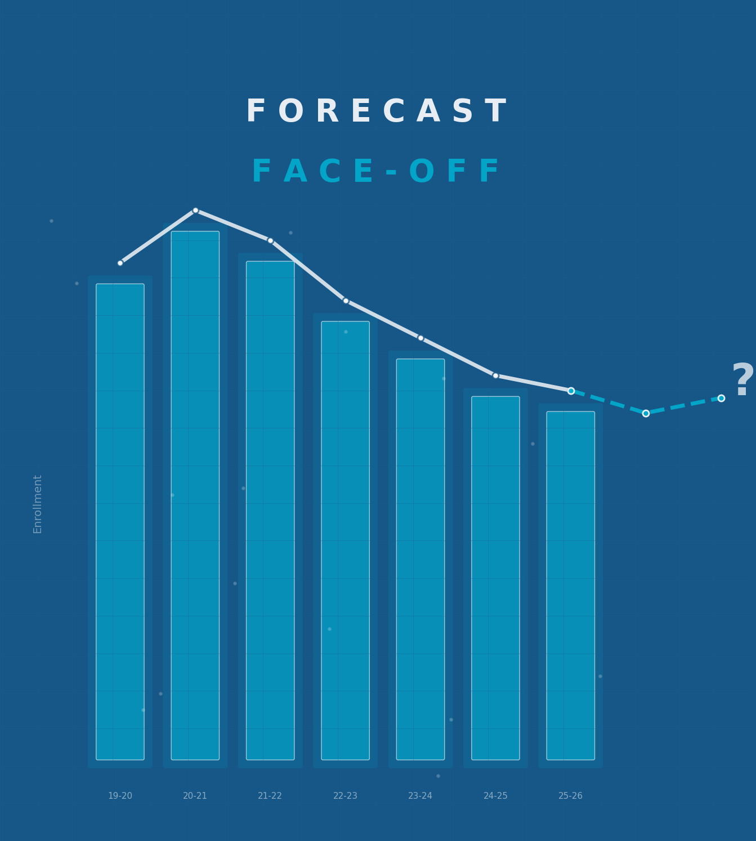
TABLE EXERCISE
Forecast Face-Off
Your table has five years of enrollment data for a fictional school and a set of contextual clues — new housing, a competing private school, declining births, and more.
Your mission: Produce a five-year enrollment forecast and identify the three key assumptions driving your projection.
15 minutes • Use the packet at your table
There are no wrong answers — the goal is to surface how assumptions shape forecasts.
When time is called, write your group’s 2030–31 forecast number in large text on your table card. Hold it up!
02 · Best Practices · p. 22

Slide 23
02 · BEST PRACTICES
Every forecast rests on two pillars
Get either pillar wrong and the whole structure wobbles. Good practice invests equally in both — and makes both inspectable.
PILLAR 1
Data
PILLAR 2
Assumptions
Official sources
Census Bureau, state vital-stats registry, state education agency, county assessor.
Historical depth
At least ten years of enrollment by grade and school. Shorter horizons can’t separate structural trends from one-year blips.
Geographic granularity
Tract, attendance-area, subdivision — not just district totals. Growth never hits every school equally.
Key streams
Resident births, Census population by age, enrollment by grade, housing permits and occupancy, boundary and program history.
Demographic
Grade-progression ratios and stability. Birth cohort translation to kindergarten. Migration by age, tenure, and school-age status. Aging-in-place and housing-turnover yield.
Structural
Attendance boundaries locked, pending, or likely to change. Residential pipeline: permitted, under-construction, planned. Single-family vs. multifamily yield factors.
Program and choice
Charter, private, and homeschool shares. Program-driven enrollment (magnet, SPED, language). Planned openings, closures, or grade reconfigurations.
Assumptions should be grounded in local context and written down.
02 · Best Practices · p. 23

Slide 24
02 · BEST PRACTICES
Different methods for forecasting. Each with their own strengths and weaknesses.
01
02
03
04
05
06
Cohort-Component
Student Yield
Hybrid
Trend Extrapolation
Regression
Micro-sim and Machine Learning /AI
Track each birth cohort from birth through grade 12. The demographic workhorse.
Housing units × students per unit. The facilities planner's tool.
Cohort-component blended with student-yield at the attendance-area level.
Fit the history, project forward. Fast and cheap, but blind to structural change.
Regress enrollment on demographic and housing predictors. Good sanity check. Often not a great
Very powerful, mostly in academia right now. Test well for certain problems. Will likely begin seeing these in production. Can be opaque.
02 · Best Practices · p. 24

Slide 25
METHOD 01 · COHORT-COMPONENT
Measuring all demographic processes in one model
METHOD 01
INPUTS
Cohort-Component
Resident births by year and tract. Historical enrollment by grade. Mortality and migration rates.
OUTPUTS
The demographic workhorse. If you can only use one method, this is probably the one.
Enrollment by grade, year, and (with tract detail) attendance area. Ten- to fifteen-year horizon.
STRENGTHS
Demographically honest. Traces mechanisms you can audit. Handles aging cohorts naturally.
Start with births in year Y. Apply survival rates to age them forward. Apply a kindergarten-capture ratio five years later. Then roll each cohort grade-by-grade using grade-progression ratios. Repeat for every cohort. Sum to enrollment.
WATCH-OUTS
Assumes grade-progression is stable. Misses housing-driven growth at the subdivision level. Needs 10+ years of data.
02 · Best Practices · p. 25

Slide 26
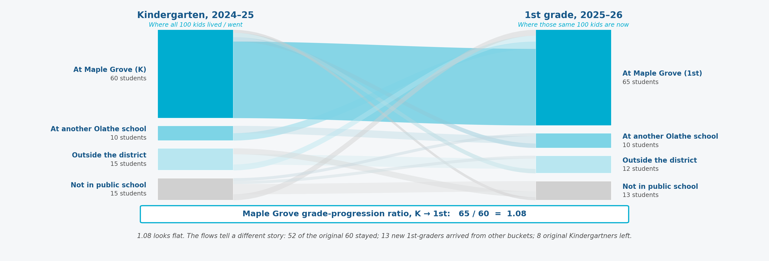
METHOD 01 · COHORT-COMPONENT
What a grade-progression ratio actually captures
One school, one year pair. The same 100 kids tracked from Kindergarten into 1st grade — staying, leaving, arriving. Every cohort-component forecast is a stack of pictures like this.
Illustrative example. Bucket sizes and flows are made up for easy arithmetic; real attendance areas are larger and noisier. The teaching point, not the numbers, is the point.
02 · Best Practices · p. 26

Slide 27
METHOD 02 · STUDENT YIELD
Forecasting enrollment from the housing stock
METHOD 02
THE IDEA
Student Yield
Different housing generates different numbers of students. A new single-family subdivision yields more school-age children per unit than an aging neighborhood or a multifamily complex. Yield factors capture that relationship and turn a housing inventory into an enrollment forecast.
The facilities planner’s tool. Forecast enrollment from the housing stock, not from demographic rates.
INPUTS
Housing inventory by type (single-family, multifamily, townhome) and age. Building permits and development pipeline. Yield factors calibrated from enrollment-to-housing cross-tabs at the attendance-area level.
Inventory the housing units in each attendance area by type and age. Multiply each group by a yield factor — students per unit. Add pipeline units as they deliver. Sum to enrollment by school.
STRENGTHS
Spatially precise — allocates enrollment to attendance areas naturally. Captures housing-pipeline effects that cohort methods miss. Directly useful for facilities planning because it links enrollment to where homes are being built.
WATCH-OUTS
Yield factors are not fixed. As neighborhoods age, original families’ children graduate and next buyers may be smaller households or empty-nesters. Treating yield as constant overstates enrollment in maturing areas. Also blind to non-housing demographic shifts — migration, birth-rate changes, or charter-school competition.
02 · Best Practices · p. 27

Slide 28
METHOD 03 · HYBRID
Use both. Let each method do what it's best at.
METHOD 03
INPUTS
Cohort-Component + Student Yield
Everything cohort-component needs, plus the housing and pipeline data student-yield needs. The union, not the intersection.
OUTPUTS
The method we recommend for most districts. Gets the demographic honesty of cohort-component and the spatial precision of student-yield.
Enrollment by grade by attendance area. Scenario-ready.
STRENGTHS
Best of both methods. Detectable when either one is drifting. Gives planners the right tool at the right level.
Run cohort-component at the district level to get the total-enrollment envelope. Run student-yield at the attendance-area level to allocate the total across schools. Reconcile: the areas must sum to the district total.
WATCH-OUTS
More expensive. Needs a reconciliation step. Demands staff who understand both methodologies.
02 · Best Practices · p. 28

Slide 29
02 · BEST PRACTICES
Three disciplines every forecast needs
Quantify uncertainty. Measure accuracy. Cross-check the numbers.
QUANTIFY UNCERTAINTY
Present the forecast as a range, not a point. Low / base / high scenarios from explicit assumption changes show which levers move enrollment. Statistical prediction intervals show what the data alone implies. Named risks — a major employer closing, a charter expansion — flag what could break the assumption set entirely.
BACK-TEST ACCURACY
Compare each cycle's forecast against what actually happened — at 1, 3, and 5 years out, by grade band, and by attendance area. The hit/miss record shows where to invest more data, which assumptions to revisit, how wide the scenario bands should be, and whether the method itself needs to change.
CROSS-CHECK BEFORE SHIPPING
Grade totals sum to district total. Attendance areas sum to district. A demographer reads the numbers for plausibility — does the age pyramid make sense? Are grade-progression shifts within historical range? And a peer comparison: does the trajectory look reasonable against similar districts?
02 · Best Practices · Forecast Validation
02 · Best Practices · p. 29

Slide 30
02 · BEST PRACTICES
Four ways to measure capacity
Conflating them is the single most common source of facility-planning confusion.
Design Capacity
Functional Capacity
Maximum headcount under the as-built layout. Classrooms times target class size, without regard to actual use. Rarely the right number for decisions.
Students a building can educate under current program, staffing, and class-size policies. Subtracts specialty rooms. Almost always below design capacity. The primary planning number.
Program Capacity
Statutory Capacity
Seats in a specific program (dual-language, self-contained gifted, CTE pathway). Used for program-placement decisions, not total-building sizing.
Seats by grade per building under state law. In Kansas (HB 2553), driven by teacher count times class-size guidelines. The most visible number a district publishes.
02 · Best Practices · Capacity Definitions
02 · Best Practices · p. 30

Slide 31
02 · BEST PRACTICES
Utilization: the basic ratio
Students assigned to a building divided by that building's functional capacity. The arithmetic is simple. The judgments around it are not.
Trajectory
Distribution
Planning-area comparison
Utilization over the past five years and projected over the next five. A school at 92% today but headed to 50% is a very different planning problem than one stable at 92%.
Utilization by grade or program within the building. A school at 92% overall can have one grade severely over-enrolled and three under-enrolled. The single number hides this.
Utilization relative to nearby schools. Low utilization reads differently when a neighboring school is over-enrolled versus when the whole region is declining together.
02 · Best Practices · Utilization
02 · Best Practices · p. 31

Slide 32
02 · BEST PRACTICES
The feedback loop
Capacity and utilization feed back into forecasting. Without the loop, institutional knowledge stays on the table.
When a school is over-utilized, the district responds: boundary change, portable classroom, program move, or new school. Each of these changes the conditions the next forecast must account for. A capacity-utilization workflow that does not loop back to the forecasting analyst is leaving institutional knowledge on the table.
Forecast
Capacity Action
Next Cycle
Enrollment projection by school, grade, and year. Drives the utilization calculation that identifies pressure points.
Boundary change, portable, new school, consolidation. Each action changes the enrollment distribution the next cycle must forecast.
The forecasting analyst needs to know: what happened, what changed, and what the new baseline looks like before the next estimate.
02 · Best Practices · Feedback Loop
02 · Best Practices · p. 32

Slide 33
02 · BEST PRACTICES
Different districts, different stories — different methods fit
There's no one-size-fits-all method. The right tool depends on what's actually driving enrollment change in a given district. Two archetypes to illustrate.
WHEN HOUSING IS THE STORY
WHEN DEMOGRAPHICS IS THE STORY
Rapid-growth districts
Stable or declining districts
Student-yield carries the attendance-area detail
Cohort-component does most of the work
Cohort-component anchors the district total
Birth-cohort tracking gets more weight
Close tracking of the permit pipeline
Yield plays a supporting role on pocket growth
Scenario bands widen with pipeline uncertainty
Named risks focus on charter/private share
(Olathe sits closer to this profile)
Housing pipeline matters less than turnover
02 · Best Practices · p. 33

Slide 34
02 · BEST PRACTICES
What a reasonable forecast error looks like
A USEFUL BENCHMARK
WHAT MATTERS MORE THAN THE NUMBER
~1-5%
The habit of measuring it.
Whatever a given district's error rate turns out to be, the important discipline is the measurement itself — every cycle, for every new forecast, against what actually happened. That’s how trust is built in a forecast, and how improvements accumulate over time.
With hybrid cohort-component + student-yield methods, and ten or more years of local history, a 5-year-out forecast of district-total enrollment will typically land within about 1-5% of actual. That's the rough bar for good practice — not a ceiling, not a floor.
02 · Best Practices · p. 34

Slide 35
02 · BEST PRACTICES
Three questions worth asking of any enrollment forecast
These aren't gotcha questions. They're the same ones a careful forecaster would want you to ask. Useful to keep in mind whenever a new enrollment number lands on the table.
“What are the assumptions?”
“How did the last one do?”
“What could make this wrong?”
A good forecast comes with a short, readable list of its major assumptions. Not fine print — a page you can actually read. If that page doesn't exist, the forecast is harder to interpret.
Every forecast should be easy to compare against what actually happened the last time. The comparison doesn't need to be flattering — it just needs to exist.
A single number implies more certainty than any forecast has. A range — with named drivers — invites the real conversation about risk.
02 · Best Practices · p. 35

Slide 36
03
WHERE OLATHE STANDS
How does
Olathe's practice
compare?
A friendly read across five dimensions. The short version: a lot is already working, and the opportunities are specific and addressable.
03 · Where Olathe Stands · p. 36

Slide 37
The Method
A cohort-survival backbone rolls current enrollment forward using three-year averaged grade-progression ratios at the attendance-area / subdivision level. A grid-level housing-pipeline component adds students from subdivisions under construction using observed student-yield rates. Kindergarten entry uses a K-entry ratio applied to lagged births mapped to the service area.
03 · WHERE OLATHE STANDS
How Olathe forecasts enrollment
99.2%
What Makes It Strong
district-total accuracy, 2024-25
28,454 actual vs. 28,695 estimated
Subdivision-level granularity is substantially stronger than a district-wide cohort-survival approach. The three-year averaged GPRs are a sensible smoothing choice. The geocoded-permit-to-attendance-area linkage makes the housing overlay spatially precise. The 2024-25 accuracy of 99.2% at the district total (28,454 actual vs. 28,695 estimated) is unusually strong.
A hybrid subdivision-based cohort-progression method with a housing-pipeline overlay.
03 · Where Olathe Stands · p. 37
03 · Where Olathe Stands · Forecasting Method

Slide 38
03 · WHERE OLATHE STANDS
Three capacity measures at Olathe
Each answers a different question. Together they give a complete picture of the district’s facilities.
1
2
3
Functional Capacity
Room Utilization
Staffing Capacity
The primary internal planning number. Loads general classrooms at district target class size, with Title 1 / Non-Title 1 loading distinction. Room taxonomy distinguishes classroom, K-primary, specialty, and athletics spaces. Self-contained SpEd rooms tracked separately.
A finer-grained rate measure. Accounts for the variety of spaces (full classrooms, half-classrooms, quarter-classrooms) and how many periods each is used at secondary level. Complementary to functional capacity: a school can have low functional utilization but high room utilization.
Developed for Kansas HB 2553 compliance. Driven by teacher count times class-size guidelines (K-2: 22, Gr 3: 24, Gr 4-5: 26, Gr 6-12: 28). The most visible number published. 2026-27 total: 29,593 seats against 27,852 enrolled.
03 · Where Olathe Stands · Capacity Measures
03 · Where Olathe Stands · p. 38

Slide 39
03 · WHERE OLATHE STANDS
How we looked at Olathe's current forecasting practice
Not an audit. Not a critique. A structured way of walking through five dimensions that, in our experience, matter most for the kind of evidence-based facility planning the Task Force is working toward.
What we looked at
How we describe each one
What this isn't
The district's internal forecasting workbook, the March 2026 open-enrollment narrative and staffing-capacity calculations, the room-by-room capacity inventory, the school rubric, the Boundary Study Group's historical materials, and the 2026 bond program documentation.
Two marks only: STRONG (already in line with good practice) or DEVELOPING (room to build further). No letter grades, no rank, no scorecard competition.
Not a judgment about the staff doing the work today — they're doing good work. Not a comparison to any specific district. Just a structured read, offered in good faith.
03 · Where Olathe Stands · p. 39

Slide 40
03 · WHERE OLATHE STANDS
Documentation and methodology
Two dimensions where Olathe’s practice is already strong.
DIMENSION 01
DIMENSION 02
Documentation Maturity
Methodological Rigor
The forecasting workbook and capacity inventory are preserved year over year in the same structure, making it possible to compare assumptions and outputs across vintages directly. The school rubric is documented with explicit indicators and weights. This meets the standard most peer districts lack.
The hybrid subdivision-based cohort-progression method with housing-pipeline overlay is the right method for Olathe’s size and growth profile. Three-year averaged GPRs are a sensible smoothing choice. The geocoded-permit-to-attendance-area linkage gives spatial granularity few peers achieve in-house. District-total accuracy of 99.2% in 2024-25.
STRONG
STRONG
03 · Where Olathe Stands · Dimensions 1-2
03 · Where Olathe Stands · p. 40

Slide 41
03 · WHERE OLATHE STANDS
Decision linkage and subgroup visibility
One strength, one natural place to build.
DIMENSION 03
DIMENSION 04
Decision Linkage
Subgroup Visibility
Utilization is reported at both the current year and end of forecast horizon. The Planning Area structure ties analytical outputs to the geographic units governance discussions actually use. The rubric gives facility decisions an explicit, written frame. The standing Boundary Study Group adds governance depth few peers match.
The district tracks subgroup enrollment at the district level — special-education enrollment grew ~27% over a recent ten-year window, and multilingual learners reached 6,295 in 2025-26. These data are not yet integrated into building-level forecast and utilization outputs. Adding a subgroup-by-grade view would give the Task Force visibility into program-requirement implications at specific buildings.
STRONG
DEVELOPING
03 · Where Olathe Stands · Dimensions 3-4
03 · Where Olathe Stands · p. 41

Slide 42
UNCOMMON PRACTICES
PUBLISHED FORECAST ACCURACY
Two things Olathe does that most districts don’t
99.2% district-total accuracy, 2024-25
Olathe publishes its prior-year forecast residual at each annual presentation. Most peer districts of comparable size do not present forecast accuracy publicly. This binds the analytical work to a feedback loop and makes the district’s track record visible.
Both are institutional strengths worth protecting.
STANDING BOUNDARY STUDY GROUP
20+ years of continuous operation
The Boundary Study Group has met for over twenty years, maintaining institutional memory of boundary configurations across decades. The multi-option community process gives boundary decisions legitimacy that ad hoc committees cannot match.
03 · Where Olathe Stands · p. 42
03 · Where Olathe Stands · Uncommon Practices

Slide 43
03 · WHERE OLATHE STANDS
The scorecard at a glance
Strong across the board on the paper's four organizing themes, with one natural place to build. The foundation is solid.
Documentation
Rigor
Decision Linkage
OVERALL READ
STRONG
STRONG
STRONG
A strong practice, with one natural place to build.
Versioned workbooks. Explicit weights.
Hybrid method. 99.2% accuracy.
Dual-metric display. Planning Areas. Rubric.
Subgroup Visibility
Uncommon Practices
Olathe's current practice is strong across the board relative to typical districts of its size. The one DEVELOPING mark — subgroup visibility — is a natural next step that builds on data the district already collects.
DEVELOPING
STRONG
District-level data, not yet building-level.
Published accuracy. Standing BSG.
03 · Where Olathe Stands · p. 43

Slide 44
03 · WHERE OLATHE STANDS
Recommendations: near-term process improvements
Three optional process refinements the Task Force might consider. Each produces benefits within a single forecast cycle, and none require changing the core methodology that is already working well.
1. Cell-integrity audit
2. Capacity inventory standardization
3. Scenario display clarity
Add an automated cell-integrity check to each cycle of the forecasting workbook. A lightweight preventive step. A R or VBA audit would take a half-day to write and can be re-run each cycle.
Standardize the last-updated column in the capacity inventory on a single date format and add an entry-time validation rule. The underlying information is correct; the column just needs consistent formatting to be scan-ready for external readers.
Add a scenario banner at the top of each workbook sheet and use a consistent color convention (one color family for baseline, one for alternative). Reduces cognitive load for a reader consuming a single sheet.
03 · Where Olathe Stands · p. 44

Slide 45
03 · WHERE OLATHE STANDS
Recommendations: building the evidence base
Three ways to make the district's already-strong analytical work more visible to the community and to decision-makers.
4. Public methods document
5. Annual back-test
6. Subgroup-by-grade view
Publish a short, public-facing description (2-4 pages) of the forecast's inputs, method, scenarios, and limitations. Include a one-page mapping of the three capacity measures, explaining which decisions each informs. A written record is easier to track and version than PowerPoint.
Run an annual back-test of the prior cycle's forecast against realized enrollment. Publish the residual summary in the same workbook so the method's performance is documented over time. Olathe already reports accuracy at each annual presentation -- an uncommon practice among peer districts. Formalizing it in the workbook would make that strength permanent.
Add a short subgroup-by-grade view to the utilization and forecasting outputs (at minimum, multilingual learners and students with IEPs). Building-level planning decisions should be taken with visibility into whether the subgroup composition is changing in ways that affect program requirements.
03 · Where Olathe Stands · Recommendations 4-6
03 · Where Olathe Stands · p. 45

Slide 46
03 · WHERE OLATHE STANDS
Longer-term investments
Two longer-horizon investments worth considering once the near-term practices are in place. Both are about the engineering layer beneath a method that is already the right method.
7. Probabilistic uncertainty band
8. Spreadsheet-to-script migration
Add a probabilistic uncertainty band to the ten-year forecast using the time-series-on-GPRs variant of cohort-survival. The payoff: a forecast communicated to the Board and community as a range alongside the central line, matching the uncertainty-treatment practice described in the best-practices framework. This is frontier-level practice -- very few districts of any size do it today, which speaks to the strength of the starting point.
Migrate the forecasting workbook from Excel to a scripted pipeline (R, Python, or a dedicated tool) that automates the end-to-end forecast, exposes each step to testing, and re-runs on a new data vintage with a single command. The workbook has served the district well. This is about the engineering layer beneath the model, not about changing the model.
03 · Where Olathe Stands · Recommendations 7-8
03 · Where Olathe Stands · p. 46

Slide 47
KEY TAKEAWAYS
What to take away from today
The data and analytical infrastructure Olathe has already built is what the Task Force needs to do its work.
THE FORECASTING METHOD WORKS
THE CAPACITY DATA IS DETAILED
THE OPPORTUNITIES ARE SPECIFIC
A hybrid cohort-progression method with a housing-pipeline overlay, operating at the subdivision level. 99.2% district-total accuracy in 2024-25. The core method is sound — it does not need to be replaced.
Three complementary capacity measures — functional, room utilization, and staffing — with room-level detail preserved across vintages. The utilization picture is already available by school and by planning area.
Subgroup-by-grade visibility at the building level. A public-facing methods document. Formalized back-testing. These build on what already exists — none require starting from scratch.
Key Takeaways

Slide 48
CLOSING
Thank you for the work you're doing
Serving on a Task Force like this is real work. We're grateful for your time — and for the care you're bringing to decisions that will shape Olathe kids' experience for the next decade.
For the district
For the Task Force
For the kids
Olathe staff have been unusually responsive and substantive in our conversations. It's visible in the quality of the work product.
The questions this group is asking are the right ones. That's half the battle. Most districts never get this far.
The point of all of this is that capacity shows up where students actually live. That's what good forecasting protects — students' school experience.
Closing · p. 48

Slide 49
Closing
Questions?
Christopher Dick, President & Founder
chris@demoadvisors.com · demoadvisors.com

